Slide 1
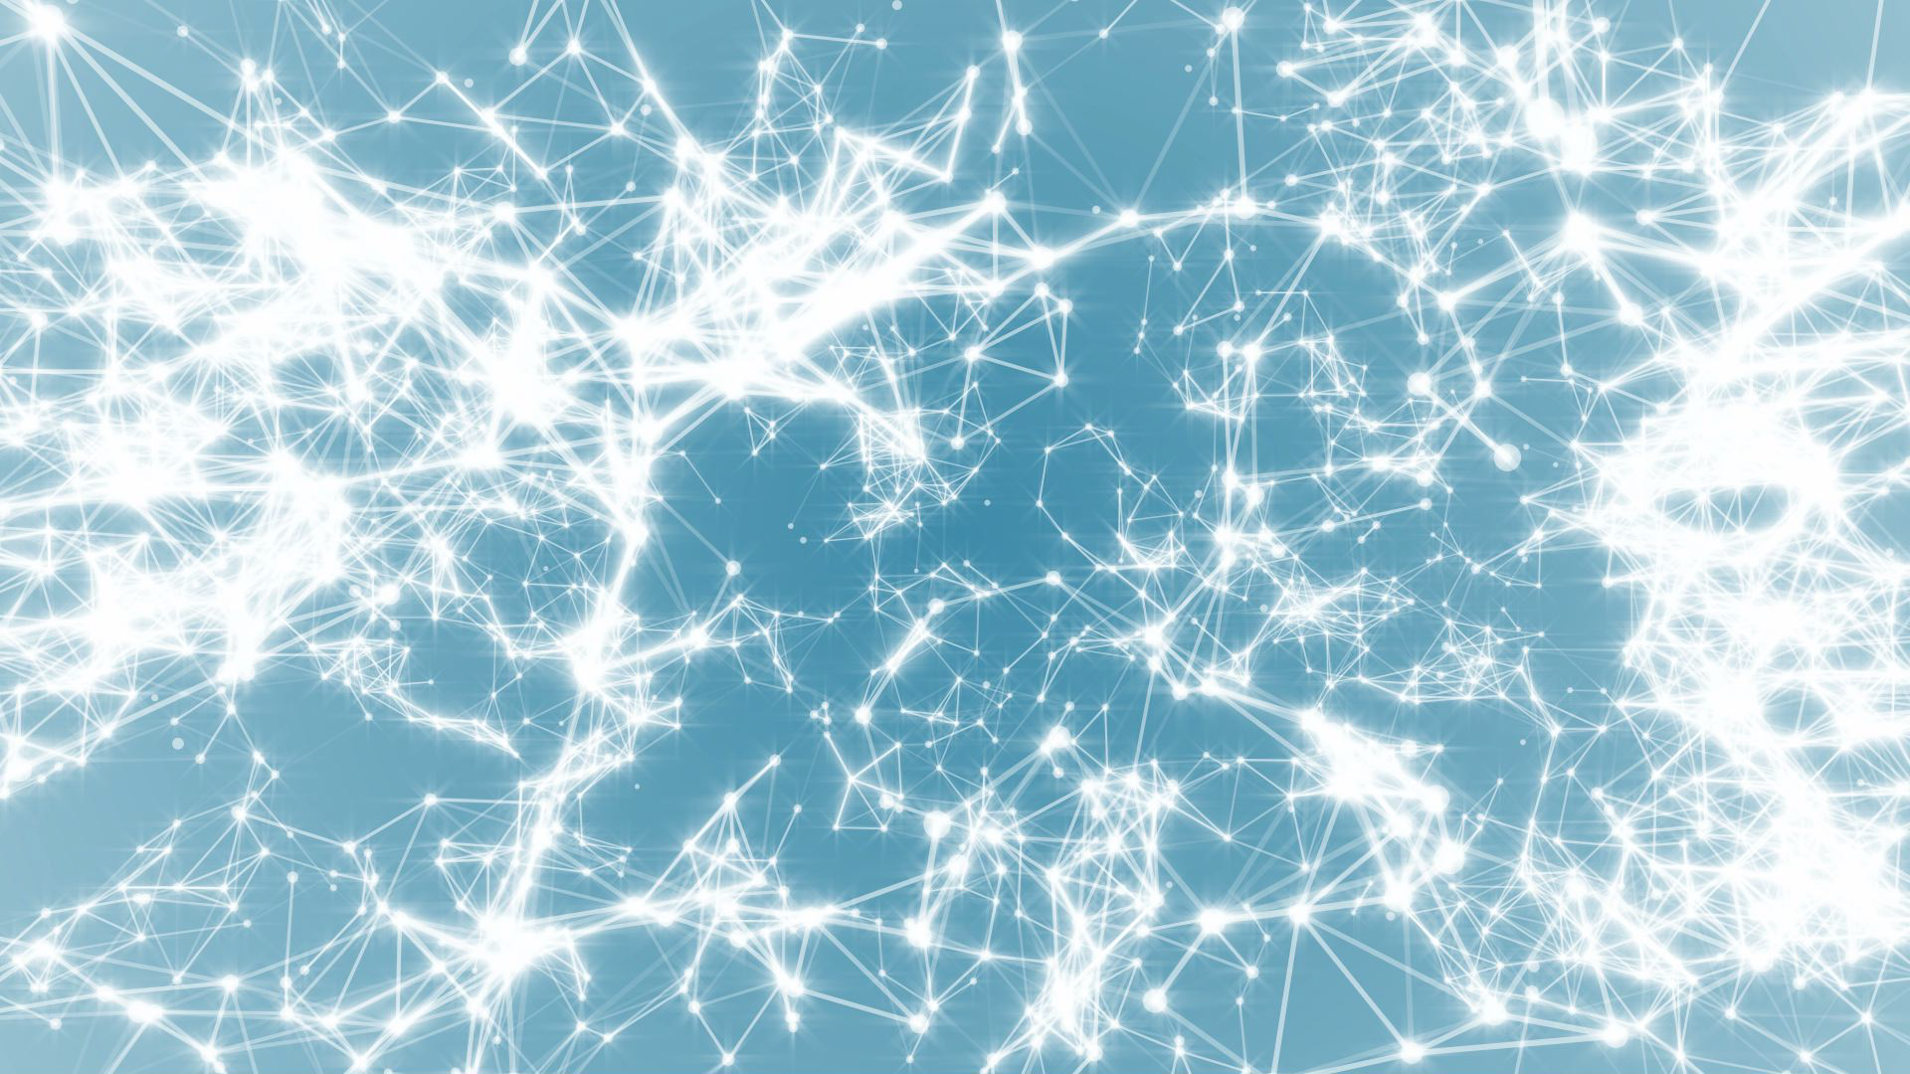
Frontiers of Network Science
Fall 2023
Class 22: Assignment 1 Solutions and Visualizations
Boleslaw Szymanski

Slide 2
Alexander Orr: Proximity Networks that Depict Contacts among People
Primary School real network visualization
Visualization BA network
Visualization of ER network. Five nodes with the largest degrees are bigger

Slide 3
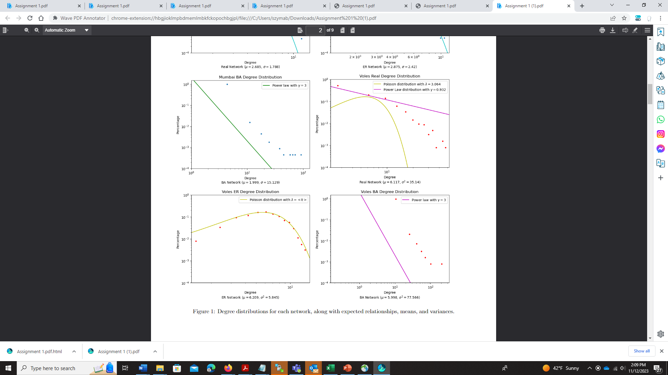
Colin Scherer: Bus Routes in Mumbai & Trapped Voles Networks

Slide 4
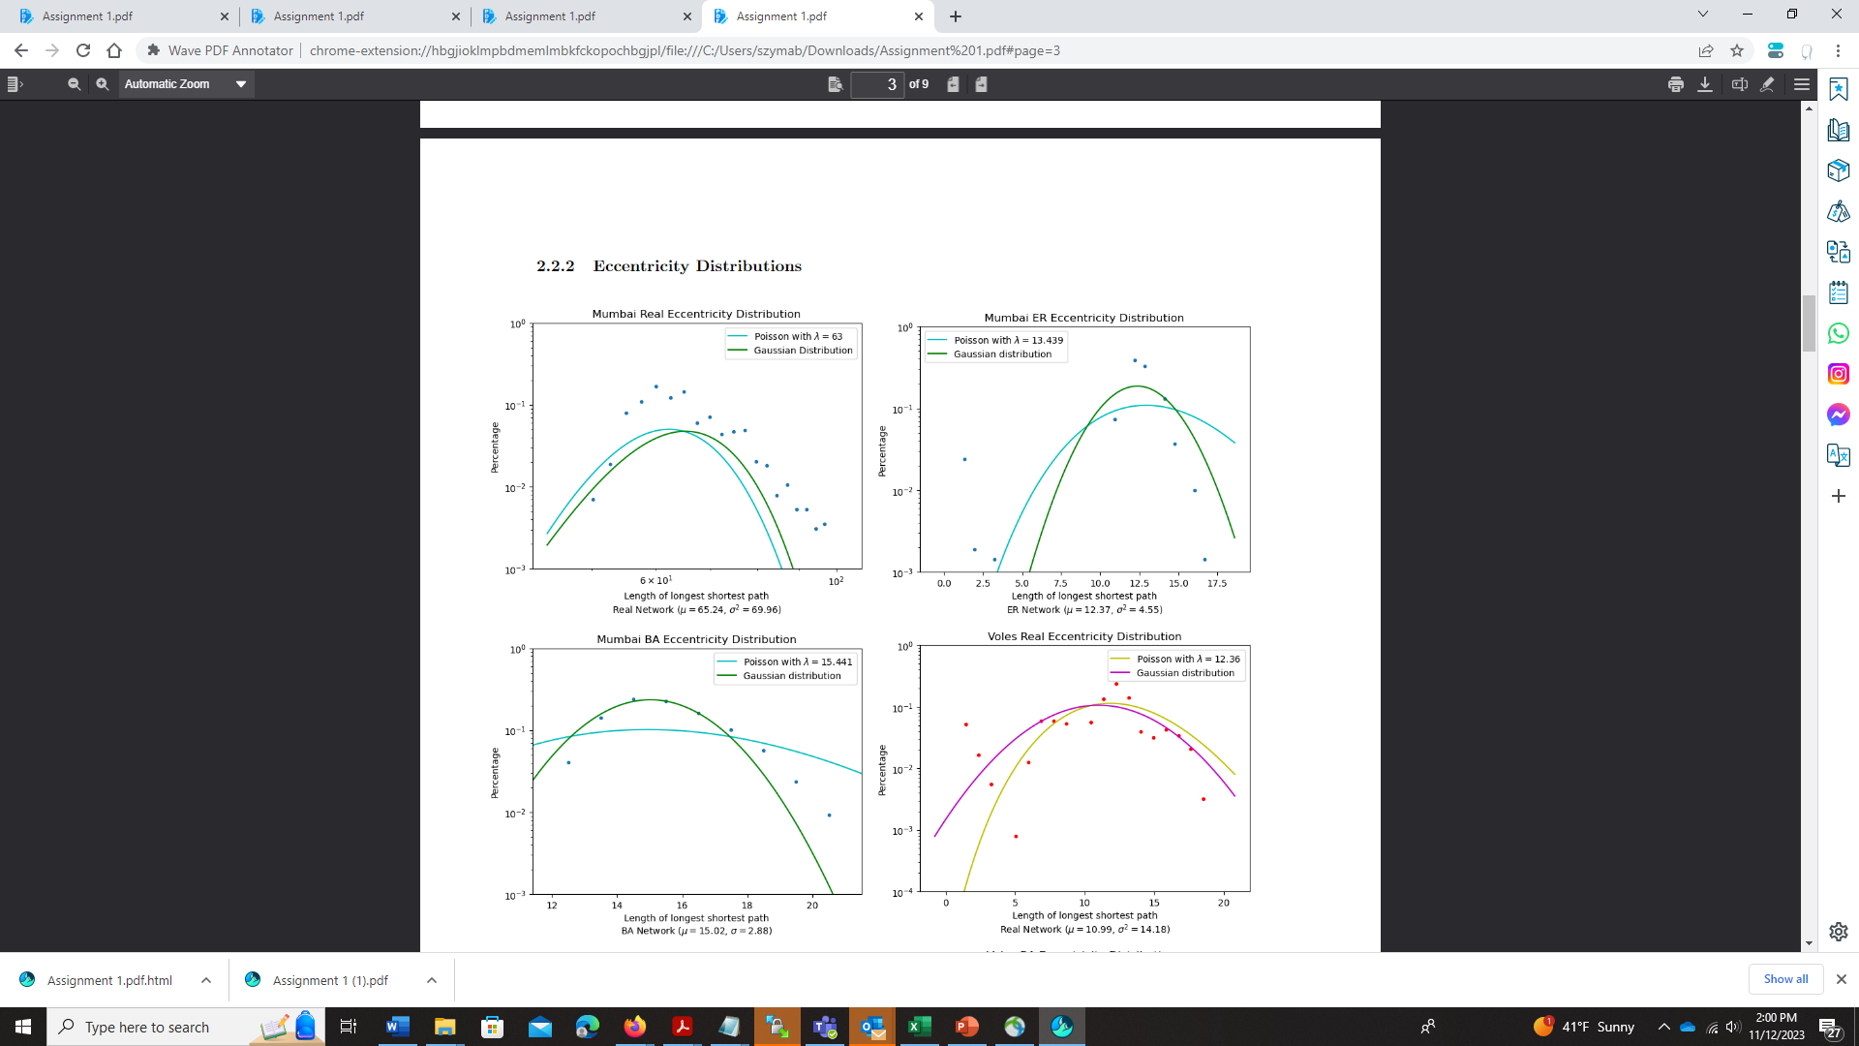
Colin Scherer: Bus Routes in Mumbai & Trapped Voles Networks Networks

Slide 5
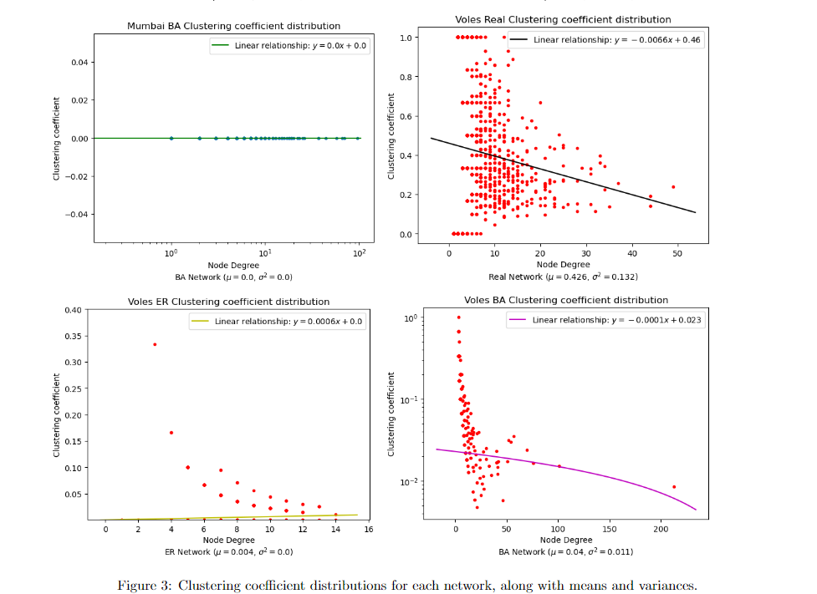
Colin Scherer: Bus Routes in Mumbai & Trapped Voles Networks Networks

Slide 6
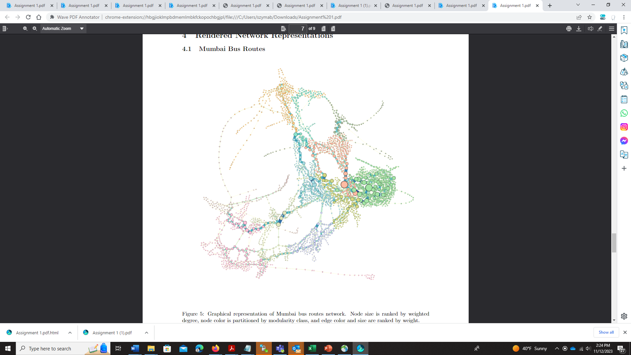
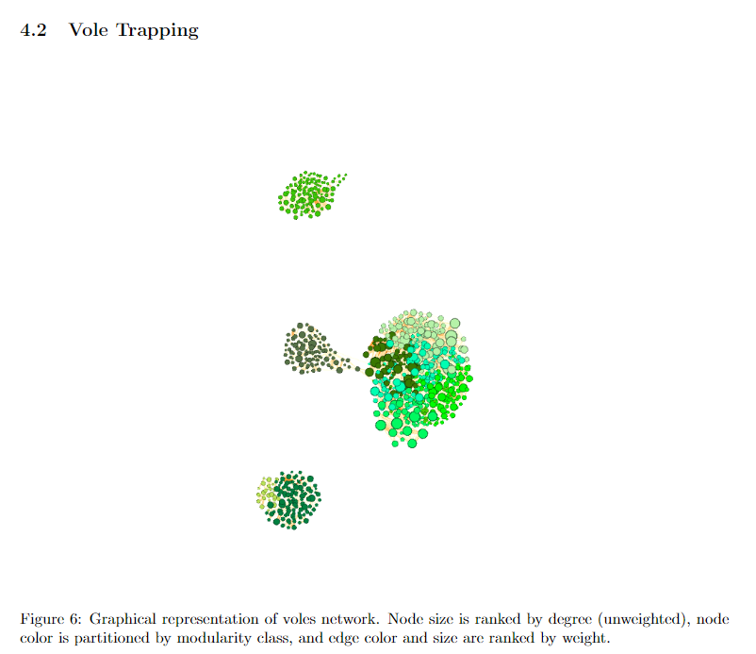
Colin Scherer: Bus Routes in Mumbai & Trapped Voles Networks Mumbai Networks

Slide 7
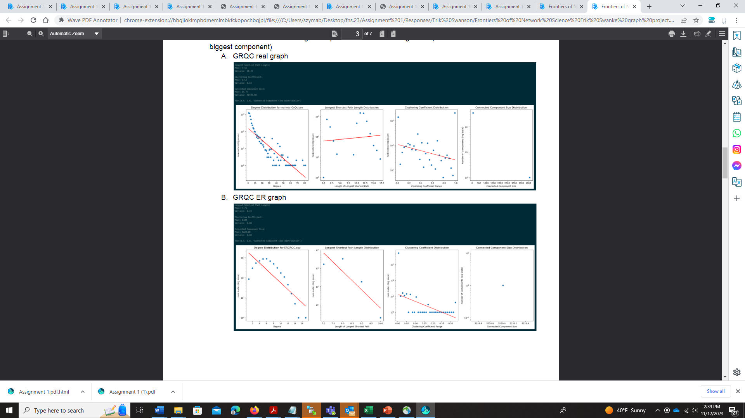
Erik Swanke: GR and QC Collaboration & Email EU Core Networks
General Relativity and Quantum Cosmology Collaboration real network
General Relativity and Quantum Cosmology Collaboration ER network

Slide 8
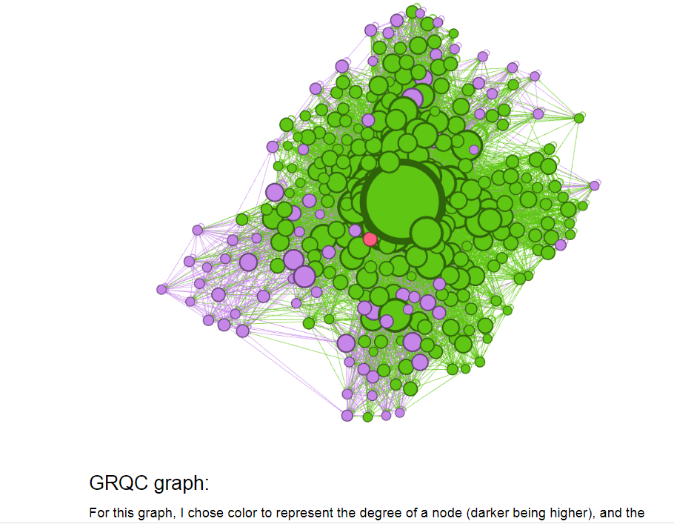
Erik Swanke: GR and QC collaboration & Email EU core networks
GRQC graph:
For this graph, I chose color to represent the degree of a node (darker being higher), and the
size to be the page-rank value. This is interesting to me because it shows that the number of
co-authors somebody has (degree) is not always correlated perfectly with the quality of these
co-authors (quality according to page-rank, I am sure they are very good scientists in their own
right).
The image shows a peak of performance in the center giving an impression nearly 3-D image.
Quite imaginative!

Slide 9
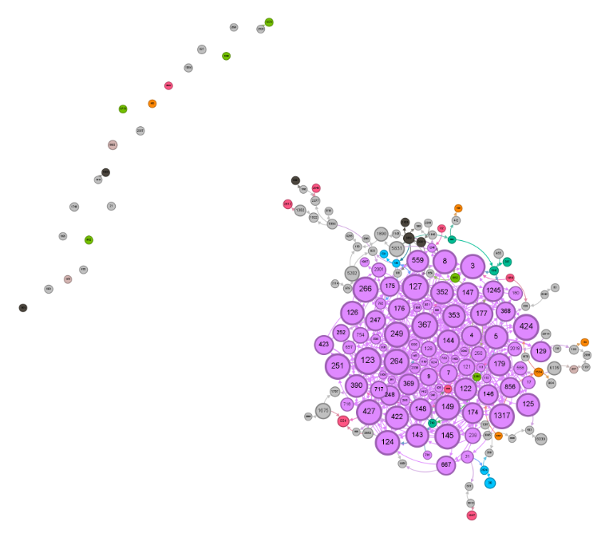
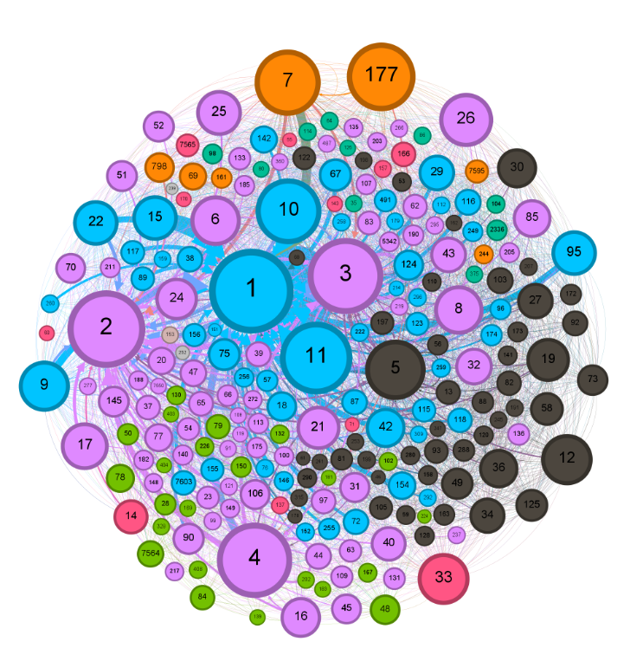
Alexander Gibson: File-sharing Gnutella & Trust Among Bitcoin Traders Networks
Node size is proportional to its degree, colors with the scale black
-grey-red-orange-blue-pink show different connected components
and their modularity with values from 0 to 12. Edges within the
same connected component are the same color as that connected
component’s modularity, while edges between different connected
components average the colors of each CC’s modularity, while
edges between different connected components average the colors
of each CC’s modularity
Node size is proportional to its degree. The same color scale
as Network 1 is used, with black nodes having modularity <35
and pink nodes having modularity >800. Edge thickness is
proportional to its weight, and edge color scale is similar
to the scale used in Network 1

Slide 10
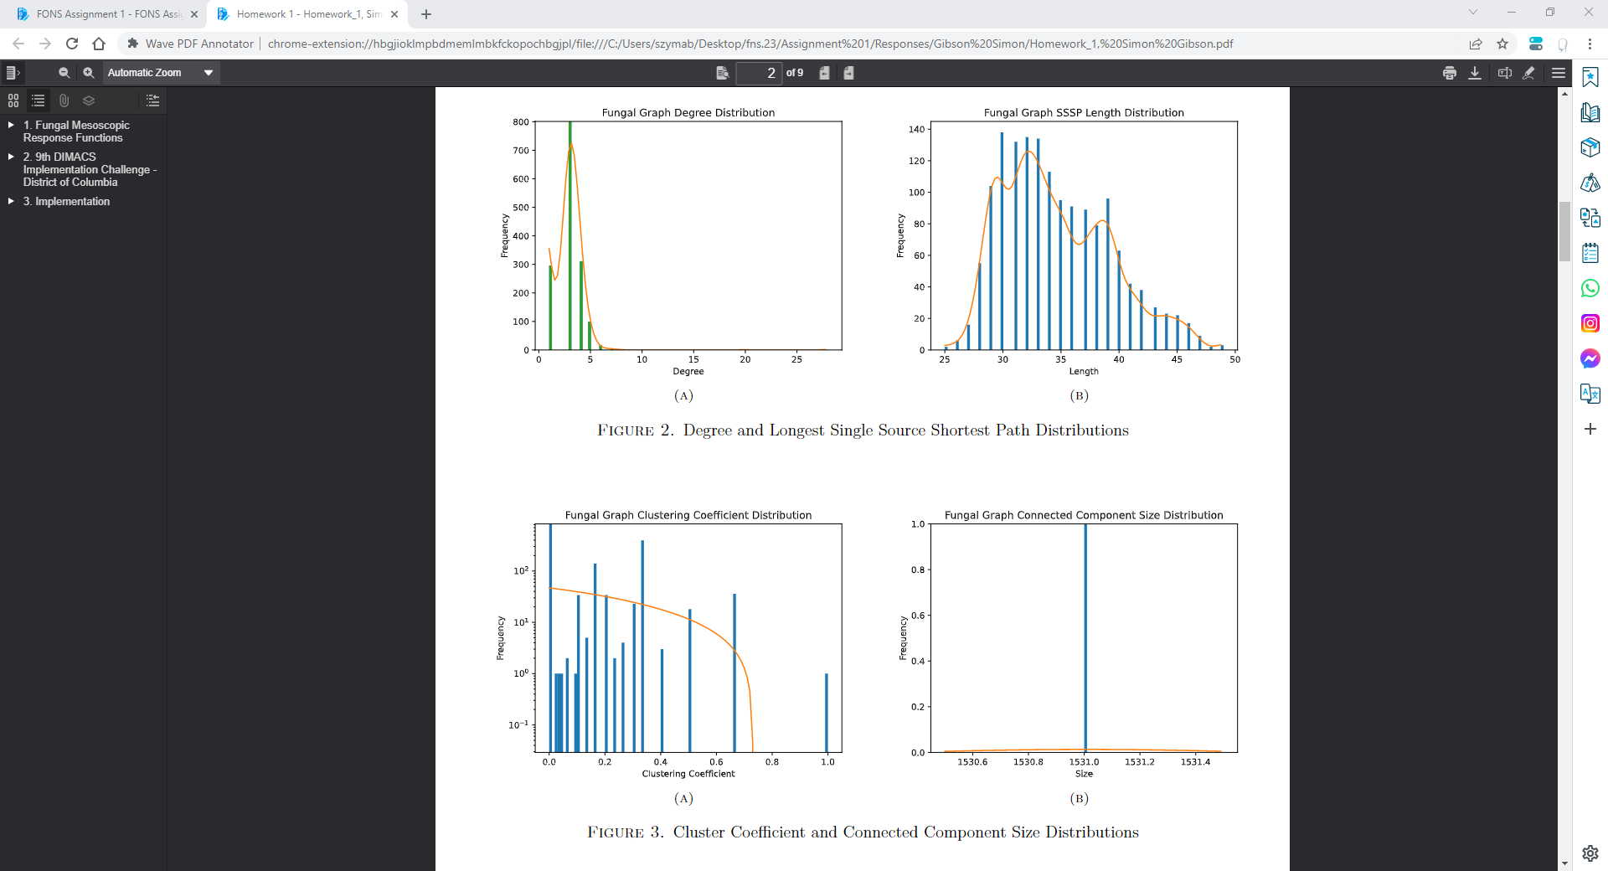
Simon Gibson: Fungal Mesoscopic Response & DC Road Networks

Slide 11
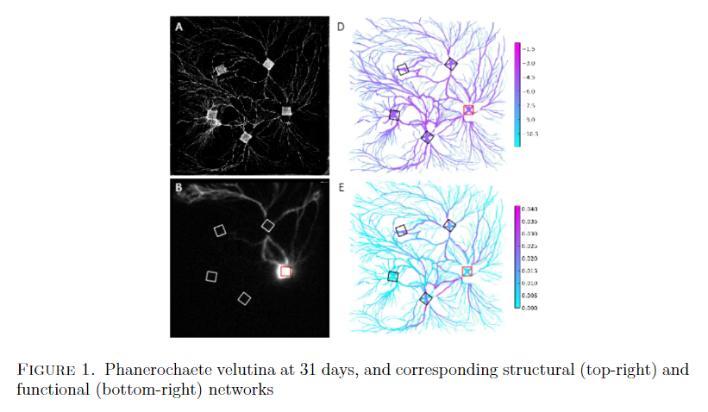
Simon Gibson: Fungal Mesoscopic Response & DC Road Networks
In the paper Mesoscale analyses of fungal networks as an approach for quantifying phenotypic traits, the authors used the structural composition and mesocale observation of various fungal growths. To measure how fungal colonies contribute to their ecosystems, fungal growths were observed for 81 days at 3-day intervals under a many conditions, including external attack from other species. At each snapshot in time, two networks are created, one structural and the other functional. Provided by the authors are numerous data sets, of which I chose day 31 of a foraging saprotrophic woodland fungus that forms reasonably dense networks. The resulting network is calculated with nodes as hyphal tips, and edges as chords among cells. Each edge was assigned a weight which is a measure of either the nutrient transport along said chord, or the ionic permeability of the hyphal tips.

Slide 12
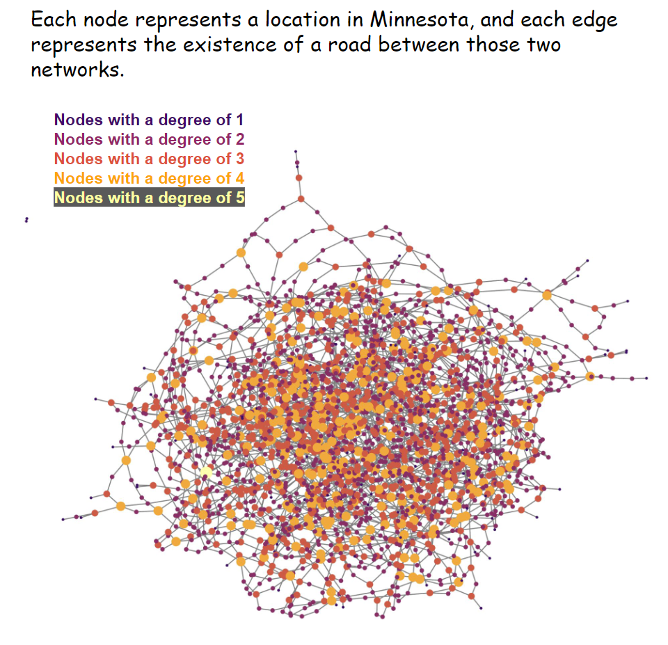
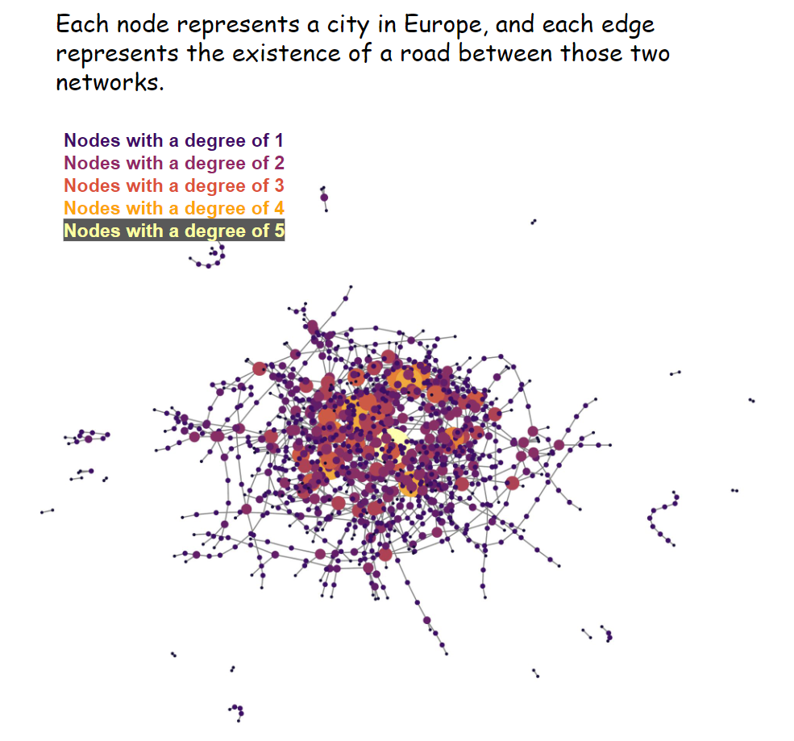
Gwin Promprated: Minnesota Road & EU Cities Road Networks

Slide 13
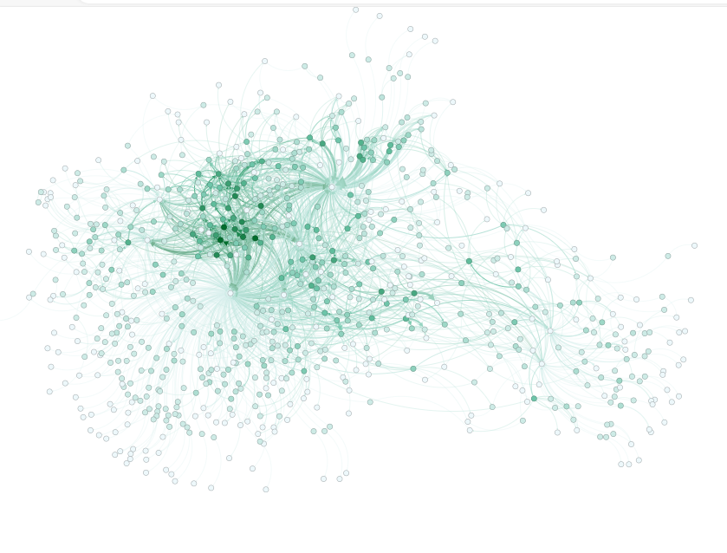
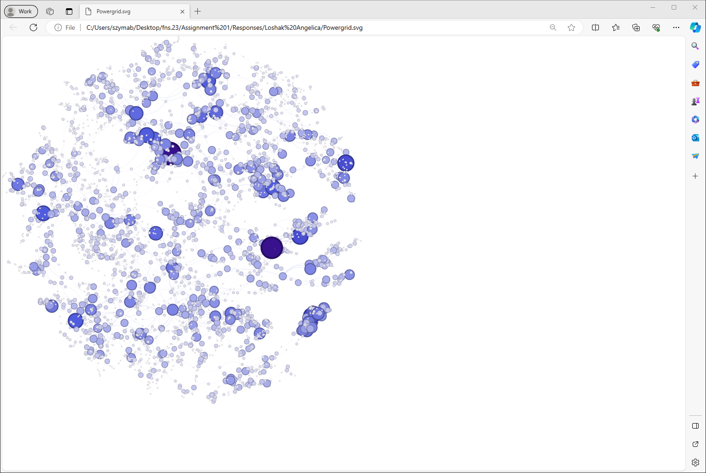
Angelica Loshak: Reptilia Tortoiser & Michigan Power Grid Networks
The Reptilia Tortoise N. Data is a network of wild, captured, and domesticated tortoise interactions. It is an unweighted, undirected graph with 796 nodes and 2218 edges. This data was collected for The American Society of Neuroradiology (ASNR) during the course of 8 months in Nevada, USA. The network is based on burrow use. Edges connect desert tortoise nodes to burrow nodes
The Power grid data is an undirected, unweighted network of 4941 nodes and 6594 edges. the data is compiled by D.
Watts and S. Strogatz. It represents the topology of Western States Power Grid in USA.

Slide 14
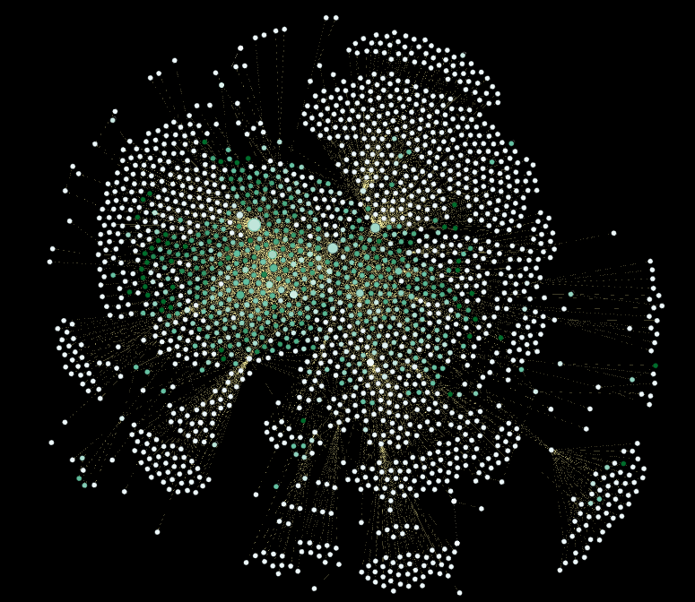
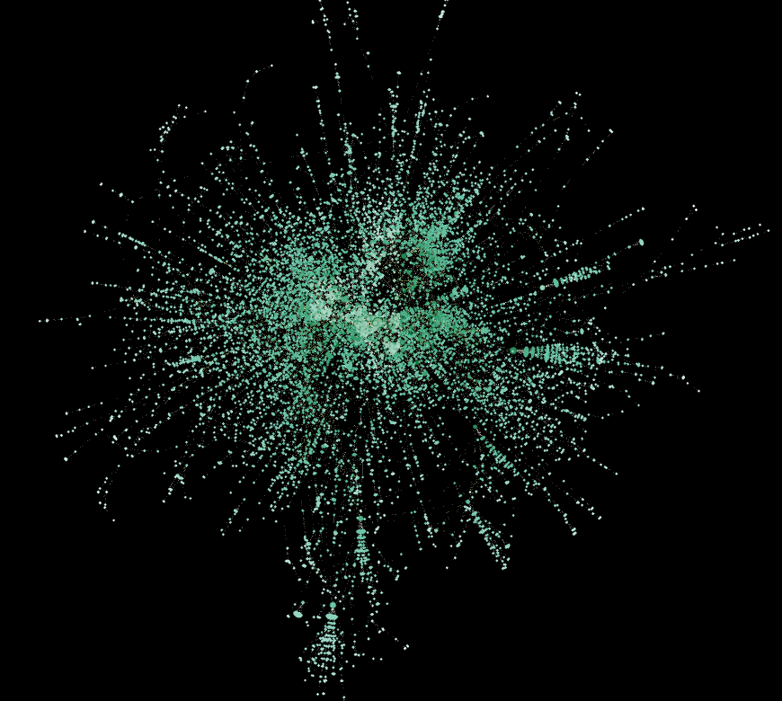
Justin Lui: DNC Email Leaks & PGP Networks
Democratic National Committee Emails Leaks Network Pretty-Good-Protection Network

Slide 15
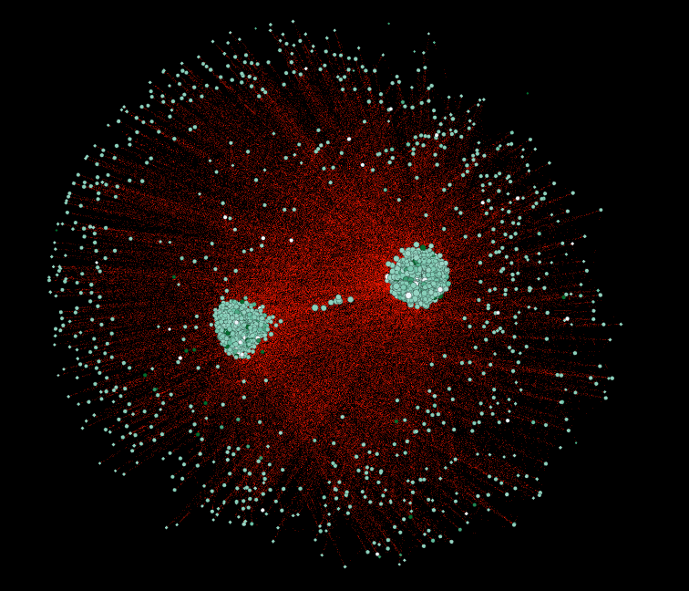
Justin Lui: DNC Email Leaks & PGP Networks
ER version of the PGP Network

Slide 16
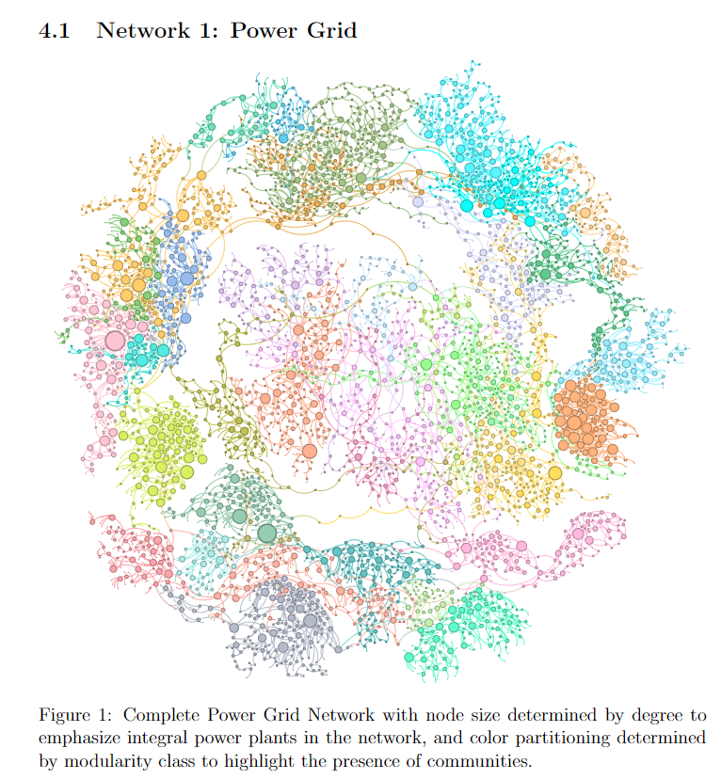
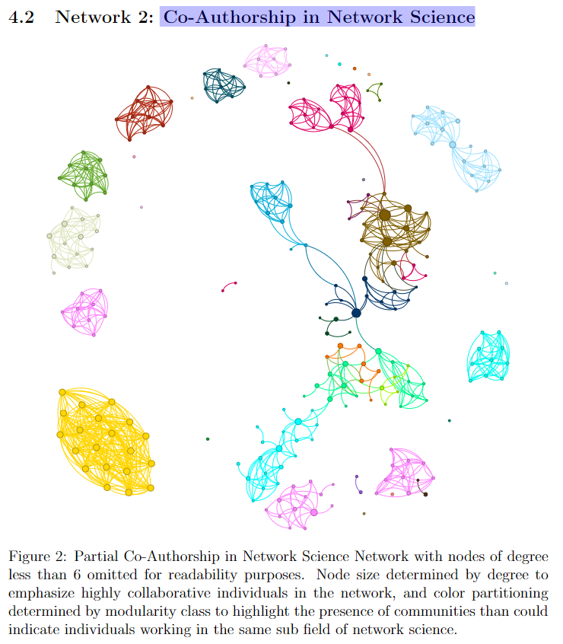
Brandon J. McCusker: Power Grid & Co-Authorship in NetSci Networks

Slide 17
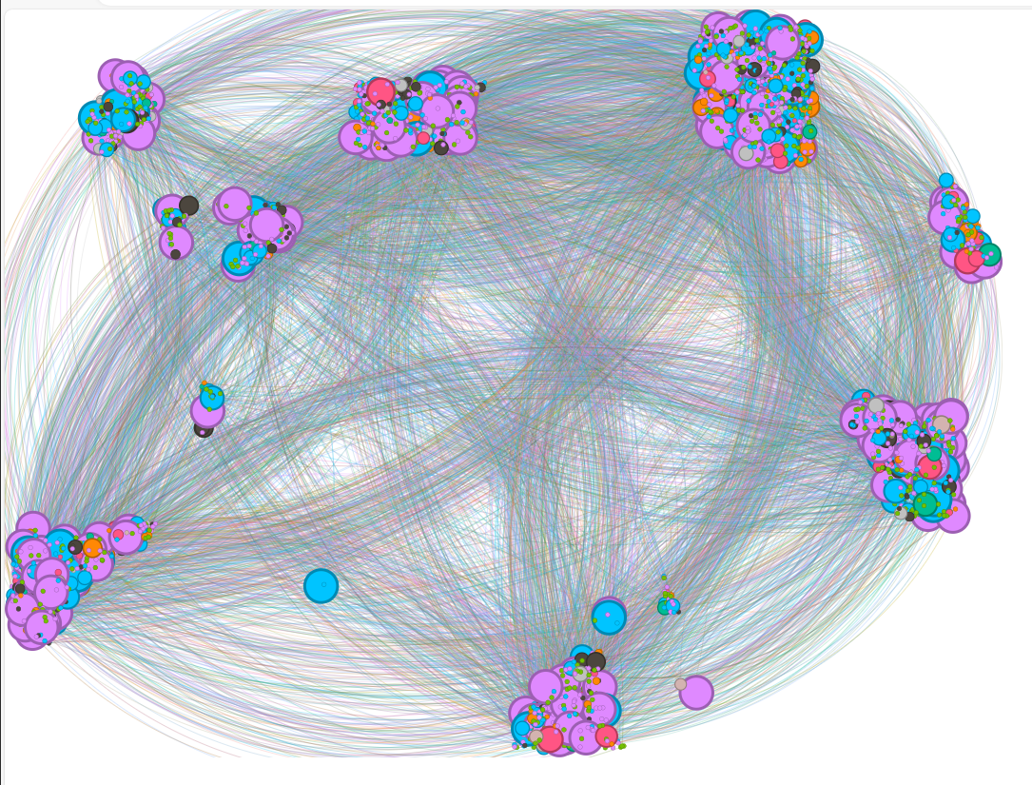
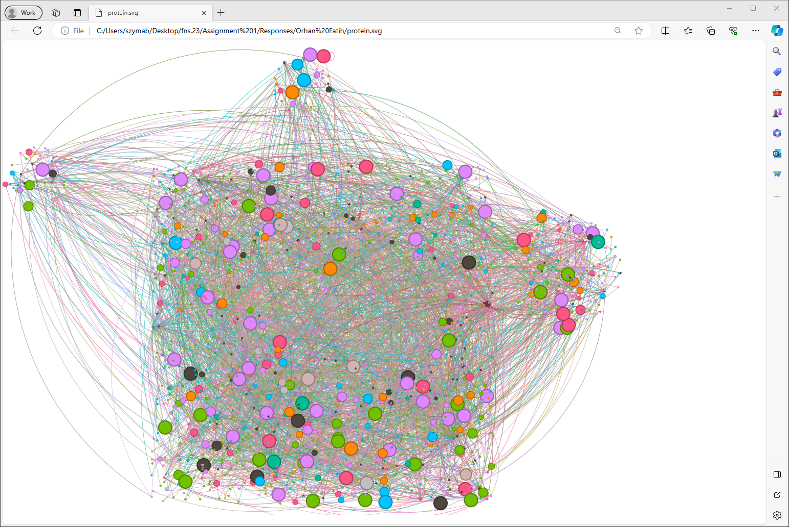
Fatih Orhan: Power Grid and Protein Networks
Power Grid: This network has 4941 nodes and 6593 edges. In the network each of the nodes represents powerplant, transformer, or a consumer. There is an edge between one node to the other if and only if nodes are connected with physical cables. This network was collected by Watts et al. in 1998. The network is undirected and unweighted.
Protein: This network is to model the protein-protein interactions in yeast. Each node in the network represents a protein and each edge represents the interactions (i.e., there’s an edge between a pair of nodes if the proteins that the nodes represent have interactions in the yeast). The network has 2018 nodes and 2930 edges. It is undirected and unweighted. This network has been used for various research areas and was first published in Science.

Slide 18
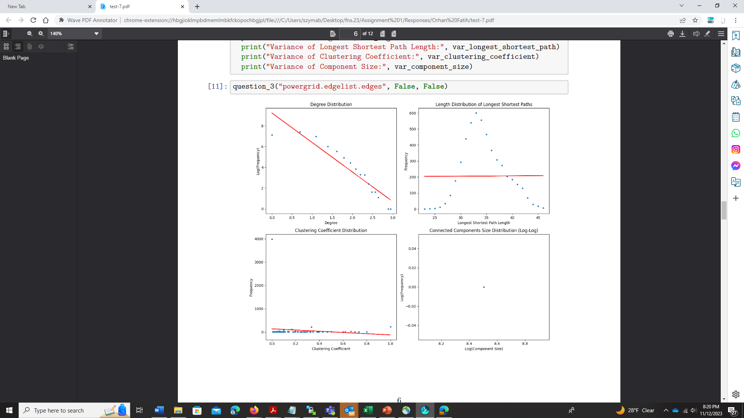
Fatih Orhan: Power Grid and Protein Networks
Power Grid original

Slide 19
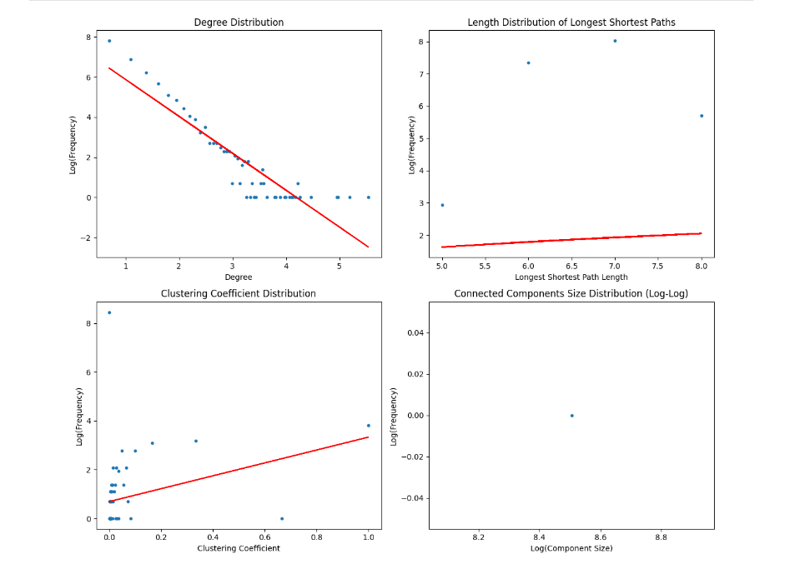
Fatih Orhan: Power Grid and Protein Networks
Power Grid ER

Slide 20
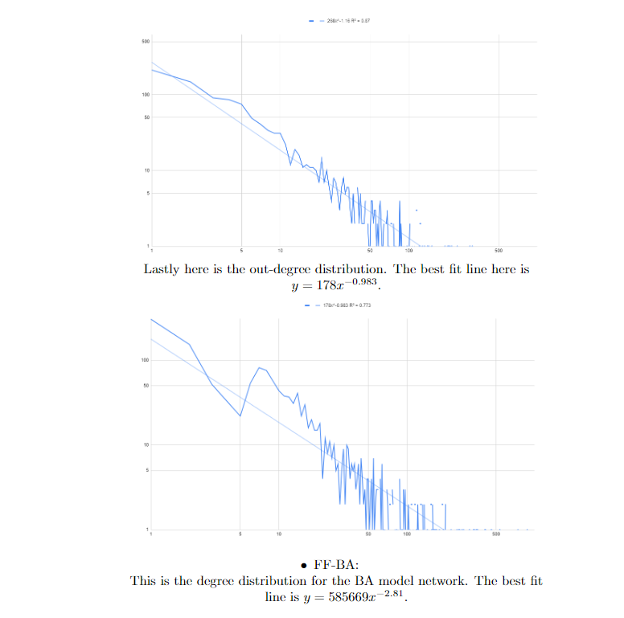
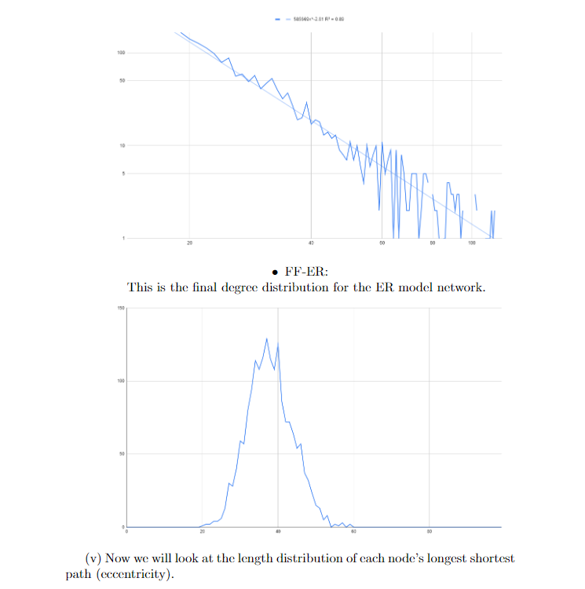
Peyton Daley: Power Grid & Fruit Fly Medulla Neural Networks
Disease-Gene association network with 7813 nodes, and 21,357 edges. 519 of the nodes represent diseases and the others represent genes. Edges between the nodes are directed and unweighted and they represent associations from a disease to a gene.

Slide 21
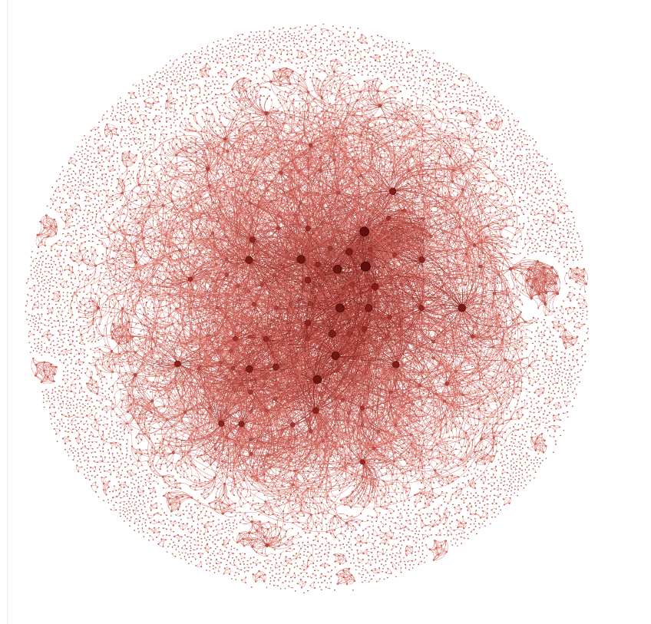
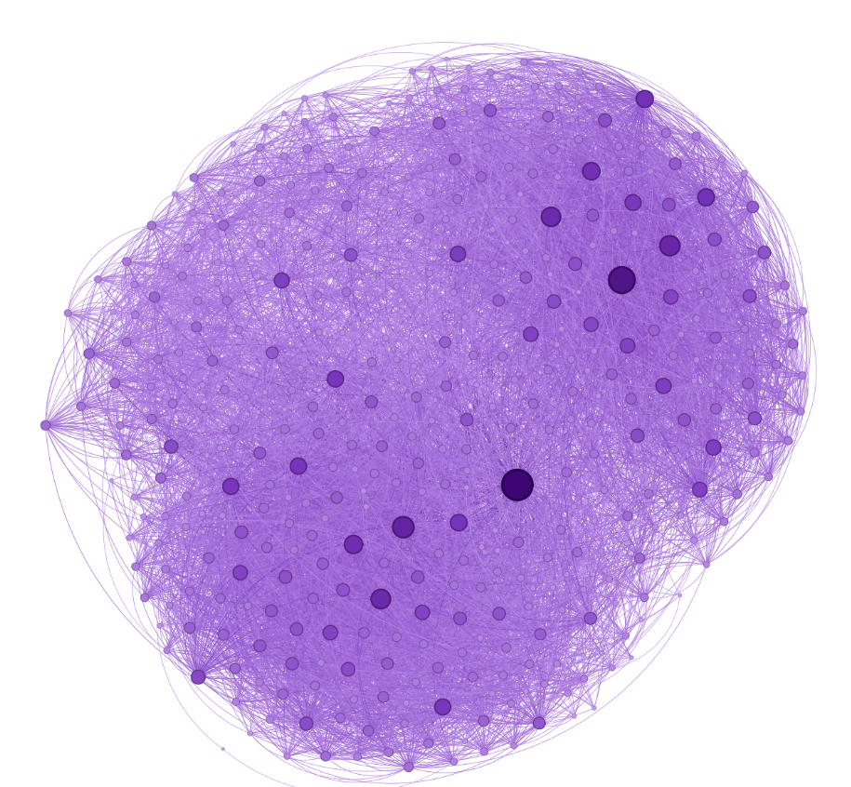
Sherpa Tashi: Twitter Interaction US Congress & Comp Geometry Collab Networks
475 members of the 117th US Congress’ Twitter’s
interactions (from January 3rd, 2021, to January 3rd, 2023.)
The network represents 7343 (number of nodes) authors, with
the undirected edges (11898) representing a link between
any two authors who wrote a joint book, article, etc. together

Slide 22
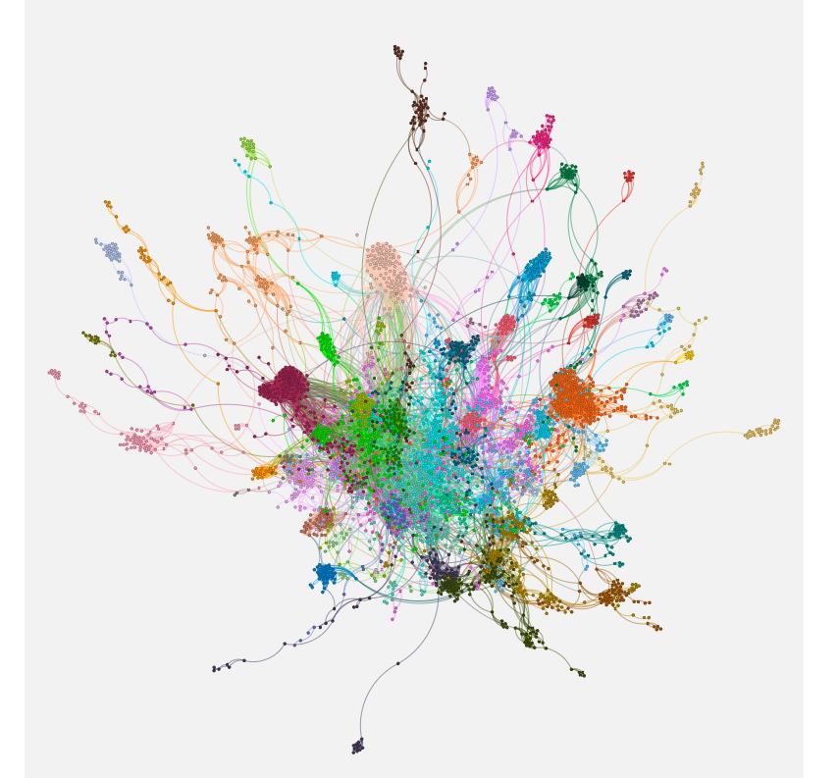
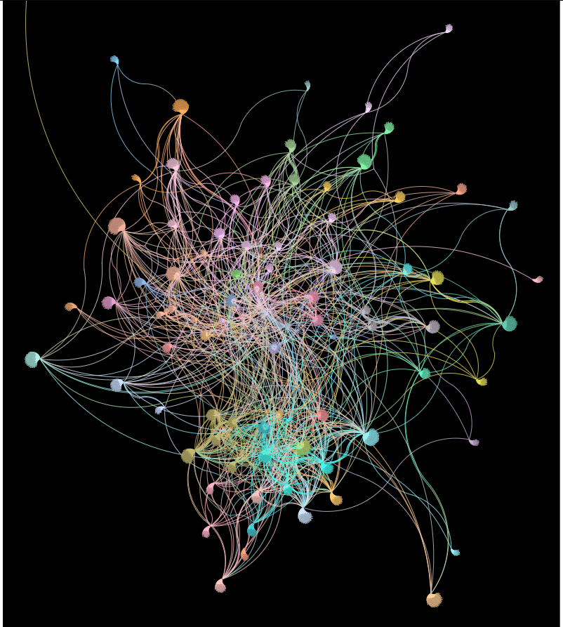
Thomas Bowen: Facebook & MIT Cell-Phone Networks
The MIT Cell-Phone nodes colors represent a phone that was used. Many of the phone calls involved un-recoreded people, that can have degree 1 resulting in of a ”fan” pattern Similar pattern arise for the Facebook nodes, where the nodes in the center are more connected with others than the ones on the outskirts.
The graph of the fb-pages-of-tv-show network. Each node color represents an fb page of a tv show, the edges represent the pages being mutually liked. An observation: the more mutually liked tv shows are the more centered they are, while the less liked shows are along the outskirts of the graph. The colors can be linked back to the name of the show.

Slide 23
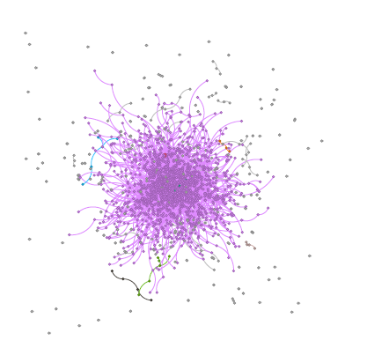
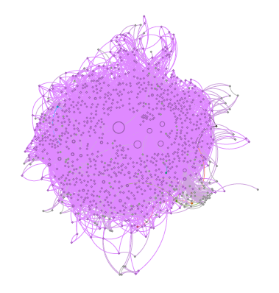
Tian: Protein & Metabolic Networks
The Metabolic Network: The color represent which connected component the node belong, and the size of the node represent the number of degree a node has, larger node means larger number of degree. My choice shows that the reaction can be classify by the connected component, and there are certain metabolite can cause more reaction than others.
The Protein Network: The color represent which connected component the node belong, and the size of the node represent the number of degree a node has, larger node means larger number of degree. My choice shows that the protein can be classify by the connected component. It can clear see that some protein have zero interaction with other. Also, diﬀerent type of pertain have zero intention with other type of protein.

Slide 24
Summary
The variety of networks is great, they come from many applications, and are interesting
Even more impressive are visualization, use of colors, shapes and placement was excellent in more than half of the assignment
The collection of results was very good, and comparing the real network to theoretical ones show how the same number of nodes and edges may end up very different topologies
The variety of approaches that you used to compute properties was also very good, from new tools, to writing pieces for specific analysis, from plots in Excel to plots of even more powerful tools, show creativity and ability to find the clever solutions.
Assignment are commented, will be send to you graded on Tuesday-Wednesday

